Slide 1
The Enhanced E-R Model and
Business Rules
EERD

Slide 2
Supertypes and Subtypes
Subtype: A subgrouping of the entities in an entity type which has attributes that are distinct from those in other subgroupings
Supertype: An generic entity type that has a relationship with one or more subtypes
Inheritance:
  Subtype entities inherit values of all attributes of the supertype
  An instance of a subtype is also an instance of the supertype

Slide 3
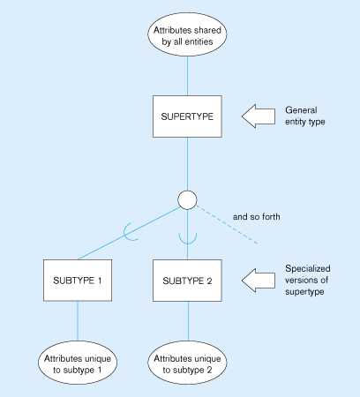
Basic notation for supertype/subtype relationships
Generalization
Specialization

Slide 4
Generalization and Specialization
Generalization: The process of defining a more general entity type from a set of more specialized entity types. BOTTOM-UP
Specialization: The process of defining one or more subtypes of the supertype, and forming supertype/subtype relationships. TOP-DOWN

Slide 5
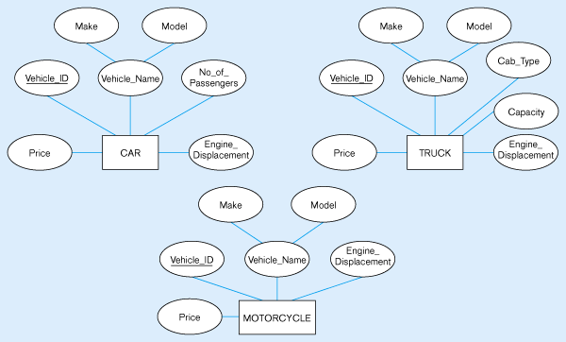
Example of generalization
(a) Three entity types: CAR, TRUCK, and MOTORCYCLE
All these types of vehicles have common attributes

Slide 6
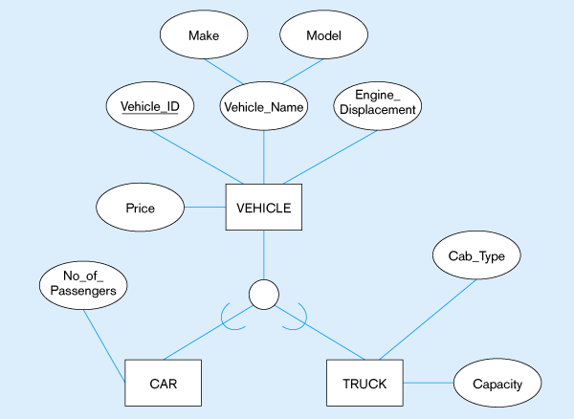
Generalization to VEHICLE supertype
So we put the shared attributes in a supertype
Note: no subtype for motorcycle, since it has no unique attributes

Slide 7
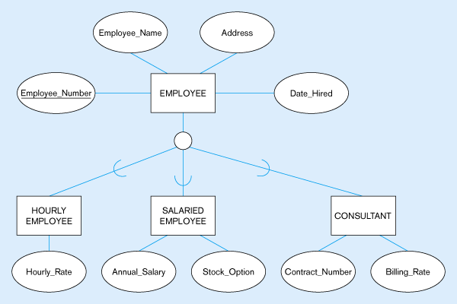
Employee supertype with three subtypes
All employee subtypes will have emp nbr, name, address, and date-hired
Each employee subtype will also have its own attributes

Slide 8
Relationships and Subtypes
Relationships at the supertype level indicate that all subtypes will participate in the relationship
The instances of a subtype may participate in a relationship unique to that subtype. In this situation, the relationship is shown at the subtype level
© Prentice Hall, 2002

Slide 9
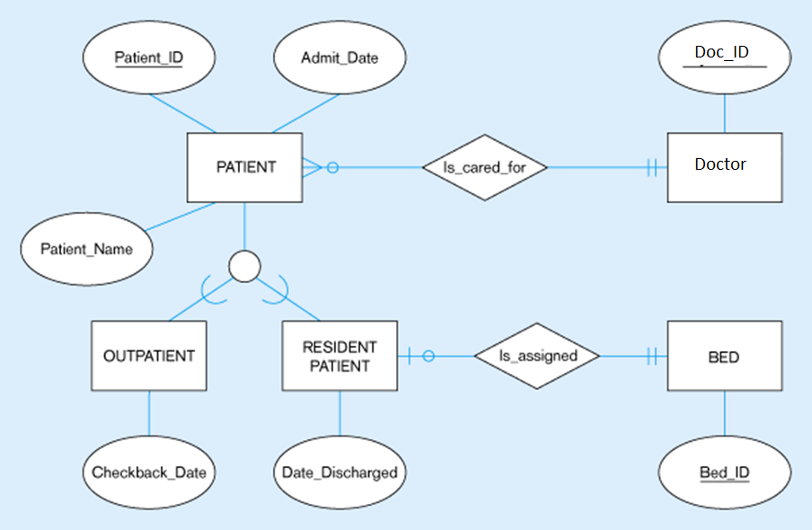
Supertype/subtype relationships in a hospital
Both outpatients and resident patients are cared for by a responsible Doctor
Only resident patients are assigned to a bed

Slide 10
Constraints in Supertype
Completeness Constraints:
    Total Specialization Rule: Yes (double line)
    Partial Specialization Rule: No (single line)
Disjointness Constraints:
    Total Disjoint (d)
    Overlap Rule (o)

Slide 11
Constraints in Supertype/ Completeness Constraint
Completeness Constraints: Whether an instance of a supertype must also be a member of at least one subtype
  Total Specialization Rule: Yes (double line)
  Partial Specialization Rule: No (single line)

Slide 12
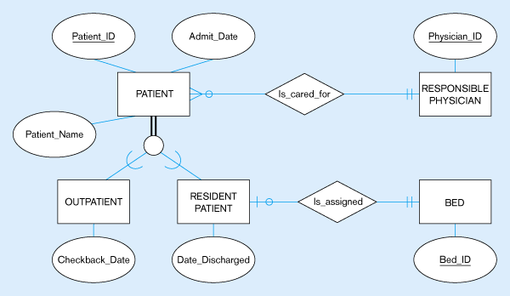
Examples of completeness constraints
Total specialization rule
A patient must be either an outpatient or a resident patient

Slide 13
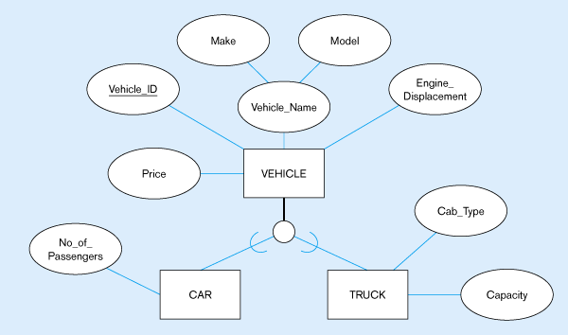
Partial specialization rule
A vehicle could be a car, a truck, or neither

Slide 14
Constraints in Supertype/ Disjointness constraint
Disjoint Constraints: Whether an instance of a supertype may simultaneously be a member of two (or more) subtypes.
  Disjoint Rule: An instance of the supertype can be only ONE of the subtypes
  Overlap Rule: An instance of the supertype could be more than one of the subtypes

Slide 15
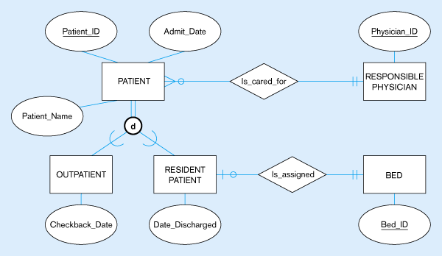
Examples of disjointness constraints
Disjoint rule
A patient can either be outpatient or resident, but not both

Slide 16
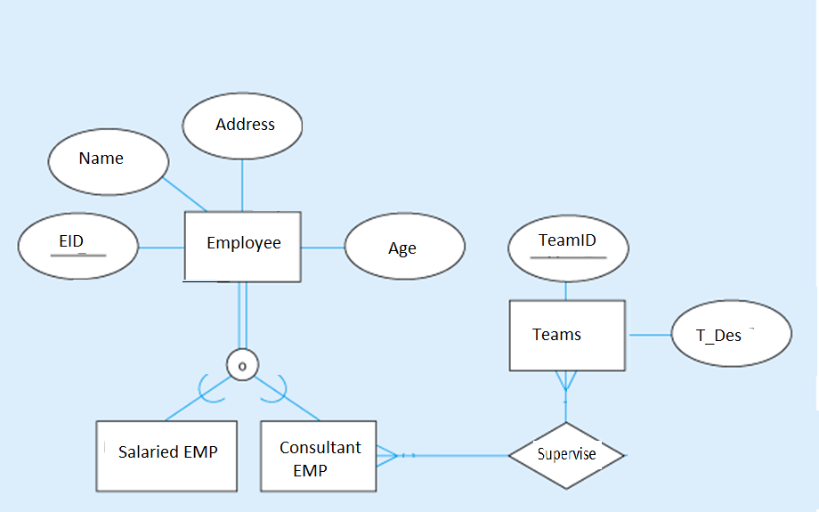
Emp may be both working by salary and consultant
Overlap rule

Slide 17
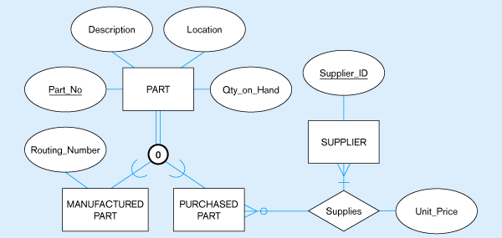
Overlap rule
A part may be both purchased and manufactured

Slide 18
Constraints in Supertype/ Subtype Discriminators
Subtype Discriminator: An attribute of the supertype whose values determine the target subtype(s)
  Disjoint – a simple attribute with alternative values to indicate the possible subtypes
  Overlapping – a composite attribute whose subparts pertain to different subtypes. Each subpart contains a boolean value to indicate whether or not the instance belongs to the associated subtype

Slide 19
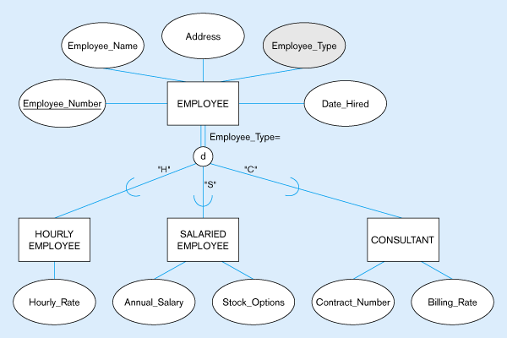
Introducing a subtype discriminator (disjoint rule)
A simple attribute with different possible values indicating the subtype

Slide 20
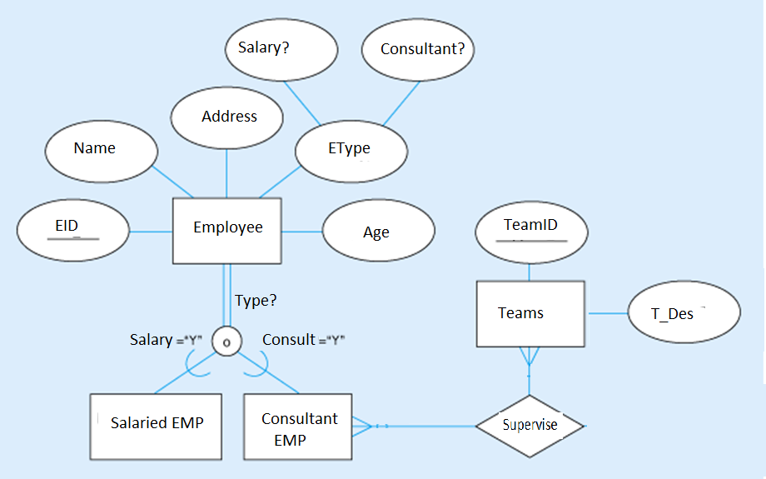
Subtype discriminator (overlap rule)
A composite attribute with sub-attributes indicating “yes” or “no” to determine whether it is of each subtype

Slide 21
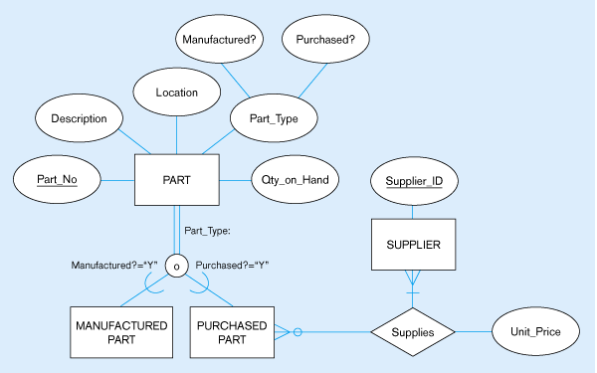
Subtype discriminator (overlap rule)
A composite attribute with sub-attributes indicating “yes” or “no” to determine whether it is of each subtype

Slide 22
Transforming EER Diagrams into Relations
Mapping Supertype/Subtype Relationships
  One relation for supertype and for each subtype
  Supertype attributes (including identifier and subtype discriminator) go into supertype relation
  Subtype attributes go into each subtype; primary key of supertype relation also becomes primary key of subtype relation
  1:1 relationship established between supertype and each subtype, with supertype as primary table

Slide 23
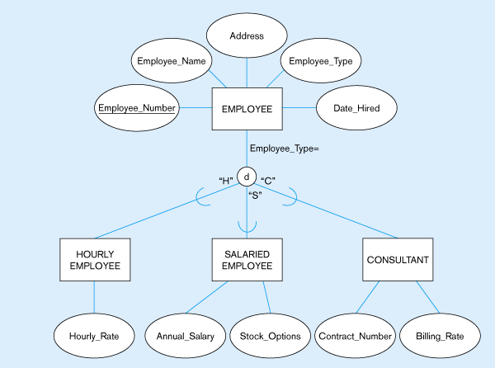
Transforming EER Diagrams into Relations

Slide 24
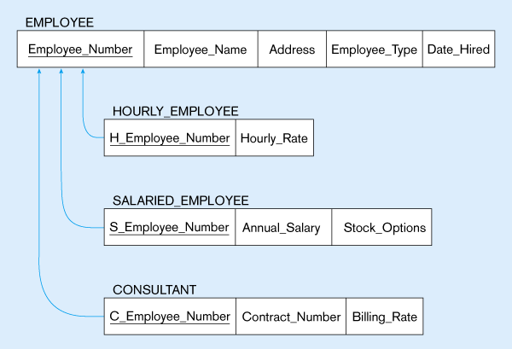
Mapping Supertype/subtype relationships to relations

Slide 25
A (100)
d
C (50)
D ( )
B (20)
o
d
E (20)
F( )
G (10)
H ( )
© Prentice Hall, 2002

Slide 26
A (100)
d
C (50)
D (30)
B ()
d
O
E (20)
F( )
G (10)
H ( )
© Prentice Hall, 2002
© Prentice Hall, 2002

